Slide 1
Notes
Assignments
3.2
3.27
3.36
3.38
3.50
Tutorial problems
Basic Problems wish Answers 3.11
Basic Problems 3.30, 3.37
Advanced Problems 3.49

Slide 2
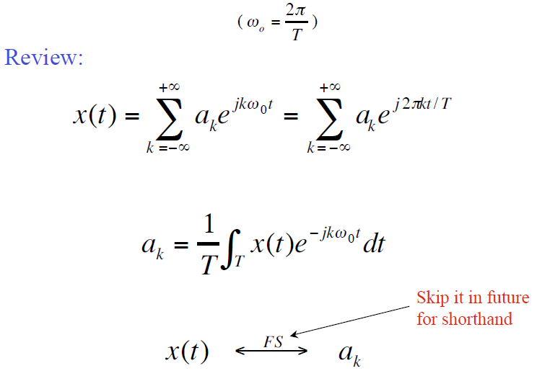
Review
2
CT Fourier Series Pairs
Frequency components are harmonically related
There exists a convergence issue on the synthesis equation
Analysis equation is a projection on the bases of periodic signal space

Slide 3
Review
Periodicity Properties of DT Complex Exponentials
For DT complex exponentials, signal are periodic only when
For DT complex exponentials, signals with frequencies ω₀ and ω₀+k•2π are identical.
We need only consider a frequency interval of length 2π, and on most cases, we use the interval: or

Slide 4
Review
4
- does not have a continually increasing rate of oscillation as is increased in magnitude.
low-frequency (slowly varying): near 0, 2π, …, or 2k • π
high-frequency (rapid variation): near ± π, …, or (2k+1) • π

Slide 5
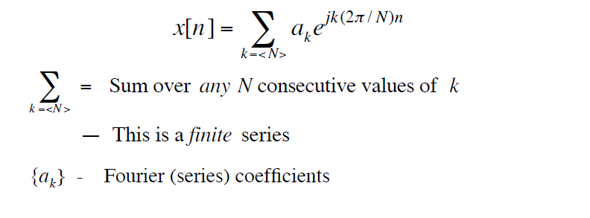
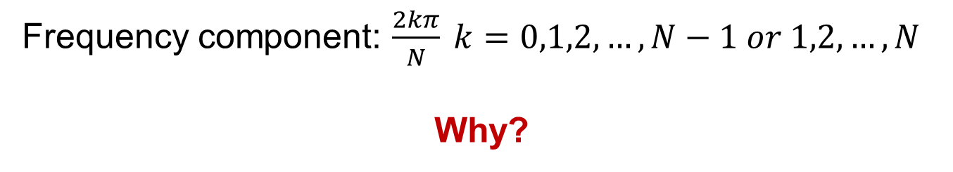
DT Fourier Series Representation
Arbitrary periodic DT signal with period N can be written as
Frequency component: $\frac{2kπ}{N} k=0,1,2,…,N−1 or 1,2,…,N$
Why?

Slide 6
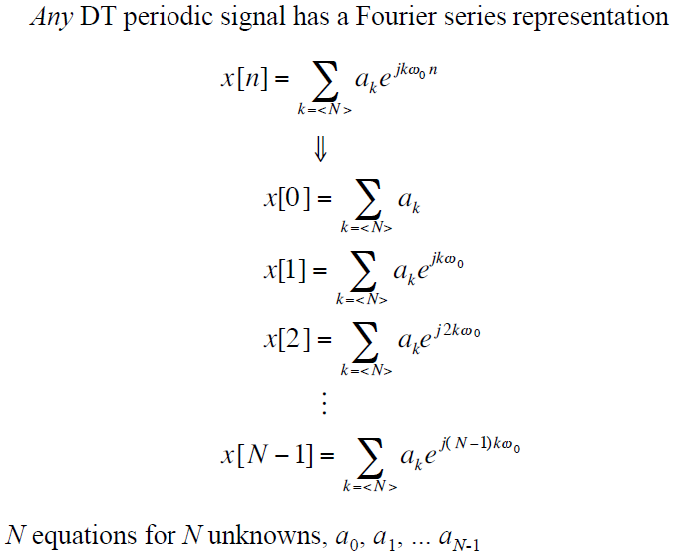

Existence
$$∀n$$
n=0
n=1
n=2
.
.
n=N-1

Slide 7
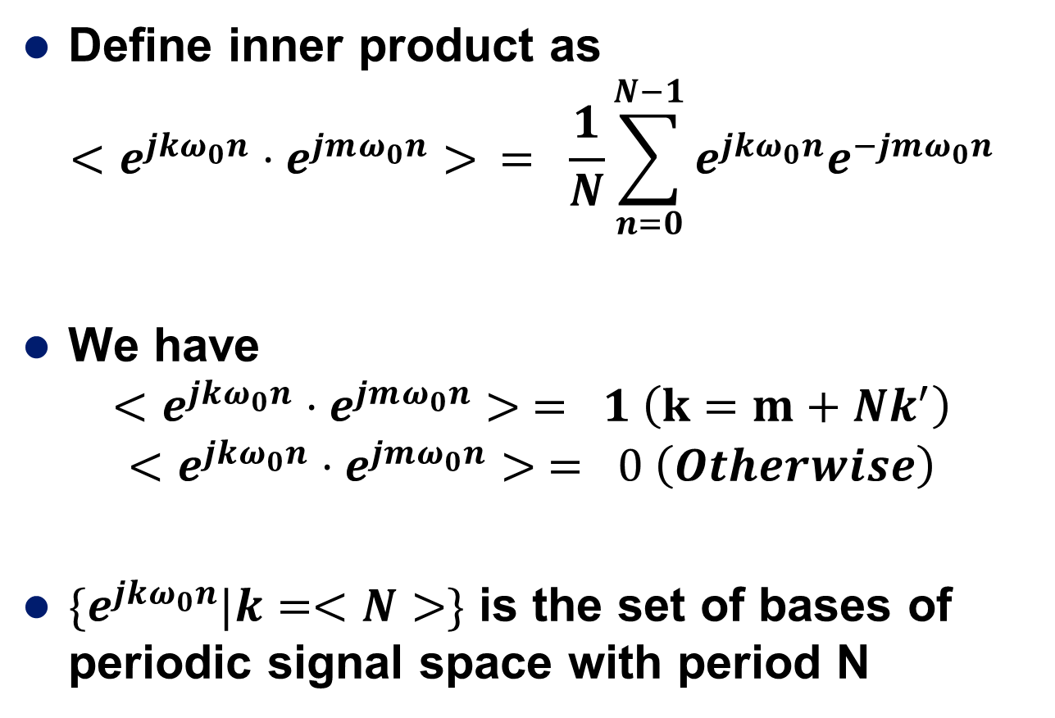
How to calculate a_{k}
Define inner product as
$$<e^{jkω_{0}n}⋅e^{jmω_{0}n}> = \frac{1}{N}\sum_{n=0}^{N−1}{e^{jkω_{0}n}e^{−jmω_{0}n}}$$
We have
$$<e^{jkω_{0}n}⋅e^{jmω_{0}n}> = 1 \left(k=m+Nk^{′}\right)$$
$$<e^{jkω_{0}n}⋅e^{jmω_{0}n}> = 0 \left(Otherwise\right)$$
$\{e^{jkω_{0}n}|k=<N>\}$ is the set of bases of periodic signal space with period N

Slide 8
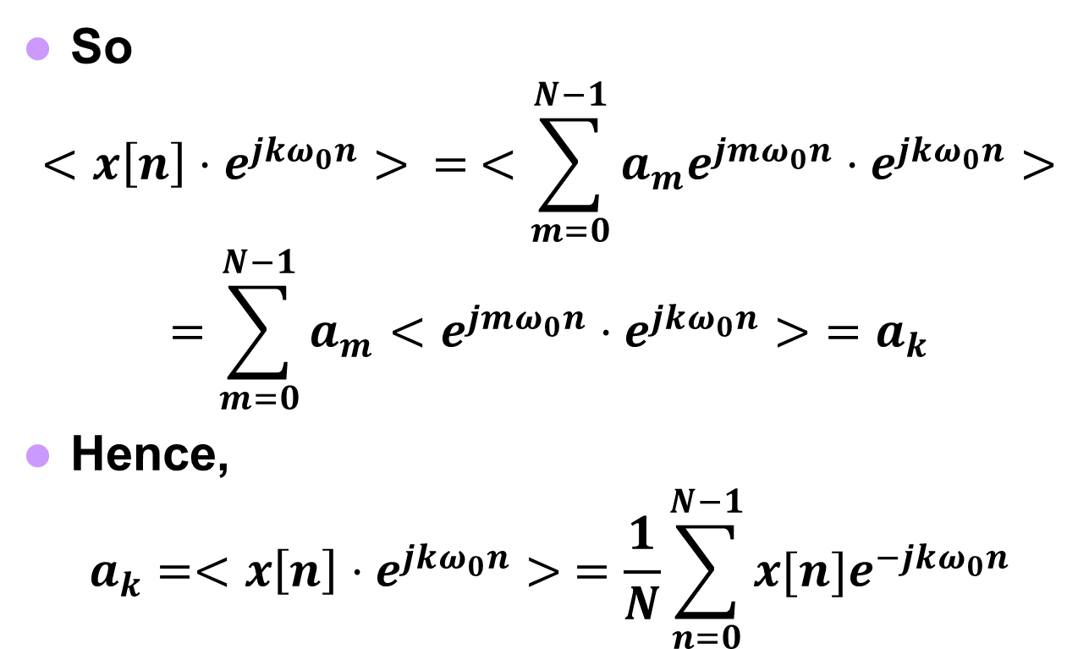
So
$$<x\left[n\right]⋅e^{jkω_{0}n}> = <\sum_{m=0}^{N−1}{a_{m}e^{jmω_{0}n}}⋅e^{jkω_{0}n}>$$
$$=\sum_{m=0}^{N−1}{a_{m}<e^{jmω_{0}n}⋅e^{jkω_{0}n}>}=a_{k}$$
Hence,
$$a_{k}=<x\left[n\right]⋅e^{jkω_{0}n}> =\frac{1}{N}\sum_{n=0}^{N−1}{x[n]e^{−jkω_{0}n}}$$

Slide 9
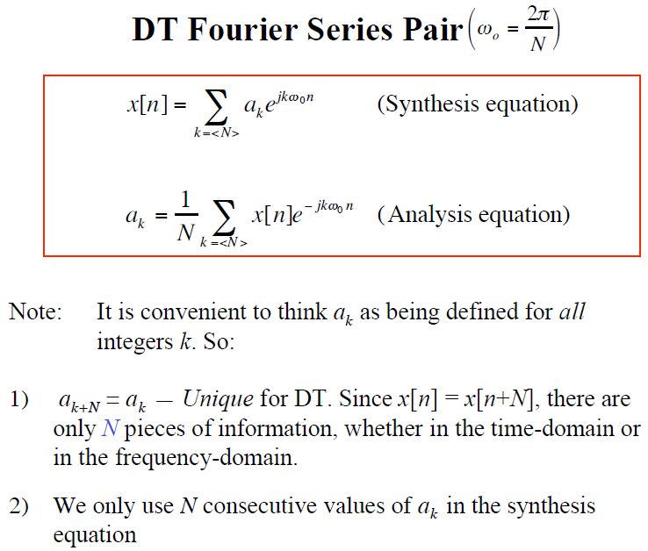
Different from CT Fourier series

Slide 10
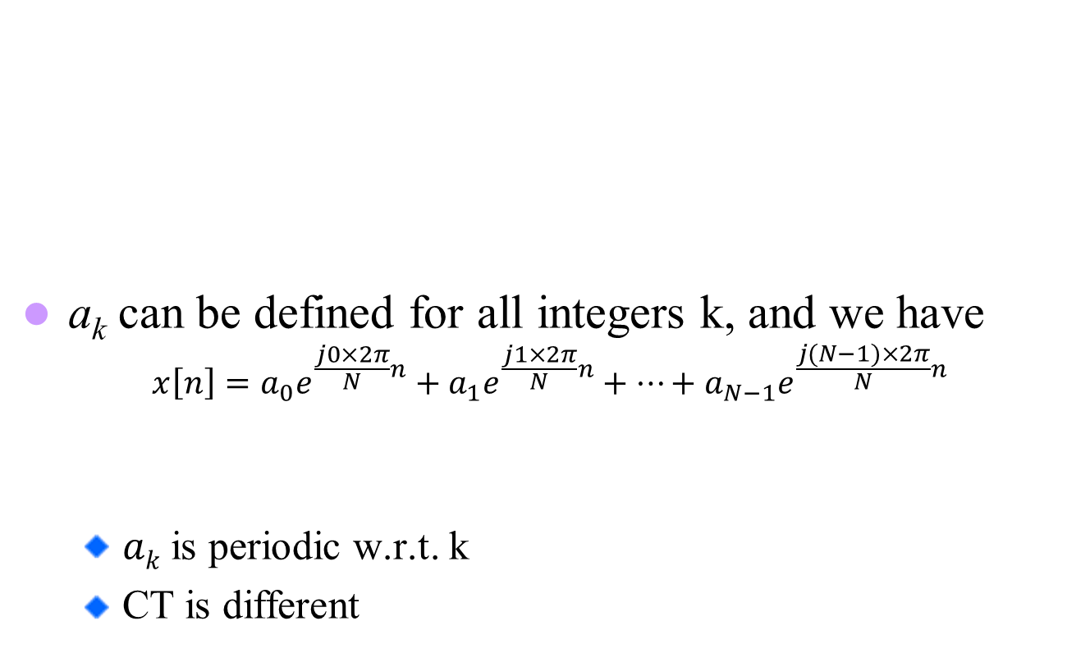
Cont.
a_{k} can be defined for all integers k, and we have
$$x\left[n\right]=a_{0}e^{\frac{j0×2π}{N}n}+a_{1}e^{\frac{j1×2π}{N}n}+…+a_{N−1}e^{\frac{j(N−1)×2π}{N}n}$$
$ak$is periodic w.r.t. k
CT is different
$$x\left[n\right]=a_{1}e^{\frac{j1×2π}{N}n}+…+a_{N−1}e^{\frac{j\left(N−1\right)×2π}{N}n}+a_{N}e^{\frac{jN×2π}{N}n}$$

Slide 11
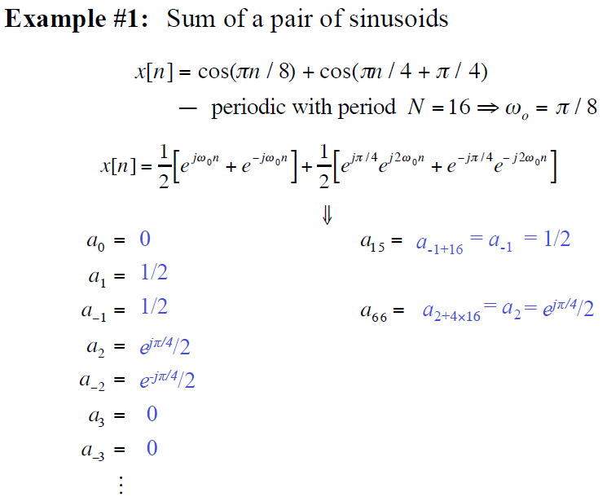
?

Slide 12
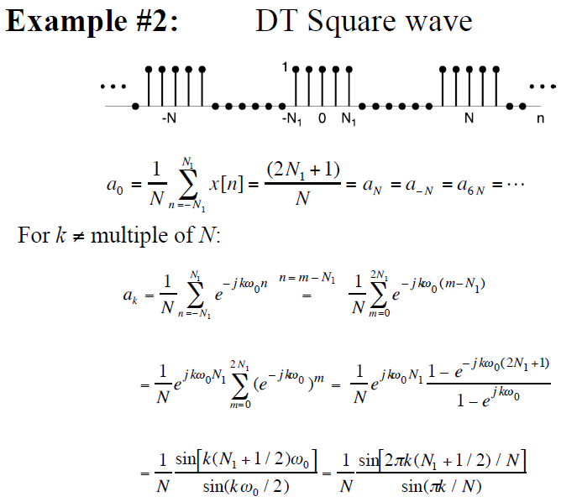
Example 3.12
Period=?
-

Slide 13
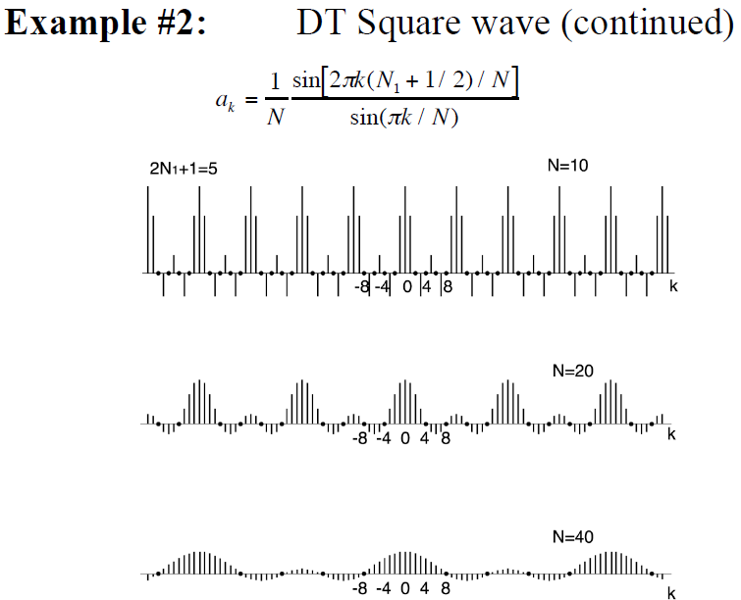

Slide 14
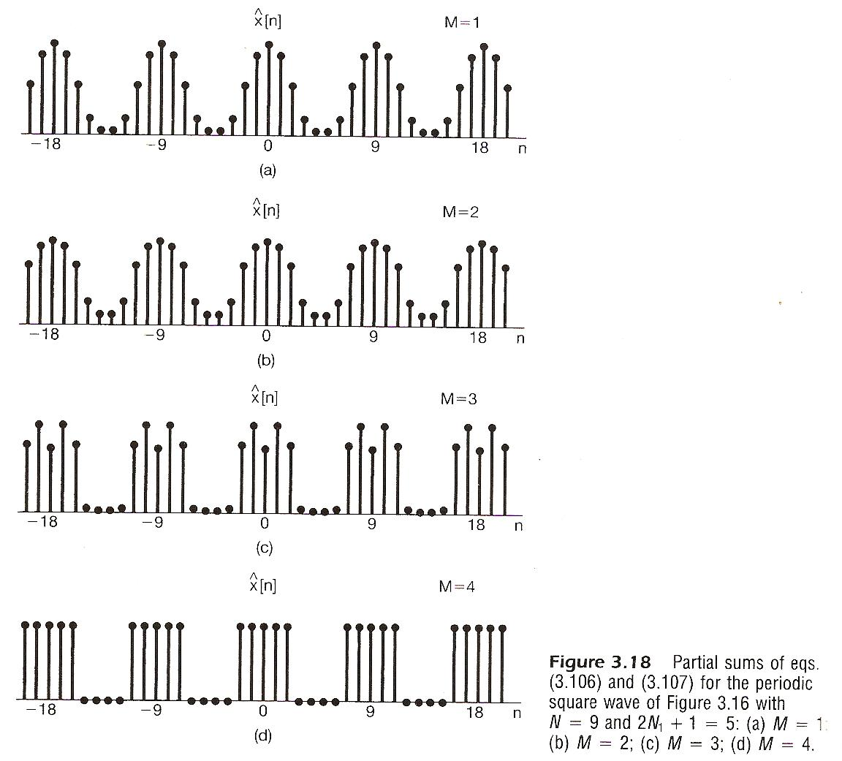
Figure. 3.18
N=9, 2N₁+1=5
k=-1,0,1
k=-2,-1,0,1,2
1) The same as original
DT square wave
2) No Gibbs phenomenon, and no discontinuity
k=-3,-4,-1,0,1,2,3
k=<9>

Slide 15
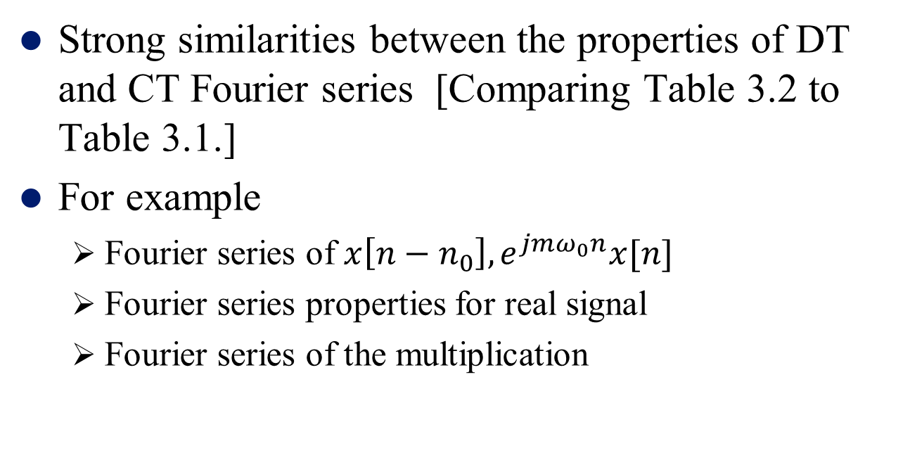
DT Fourier Series - Properties
Strong similarities between the properties of DT and CT Fourier series [Comparing Table 3.2 to Table 3.1.]
For example
Fourier series of $x\left[n−n_{0}\right], e^{jmω_{0}n}x[n]$
Fourier series properties for real signal
Fourier series of the multiplication

Slide 16
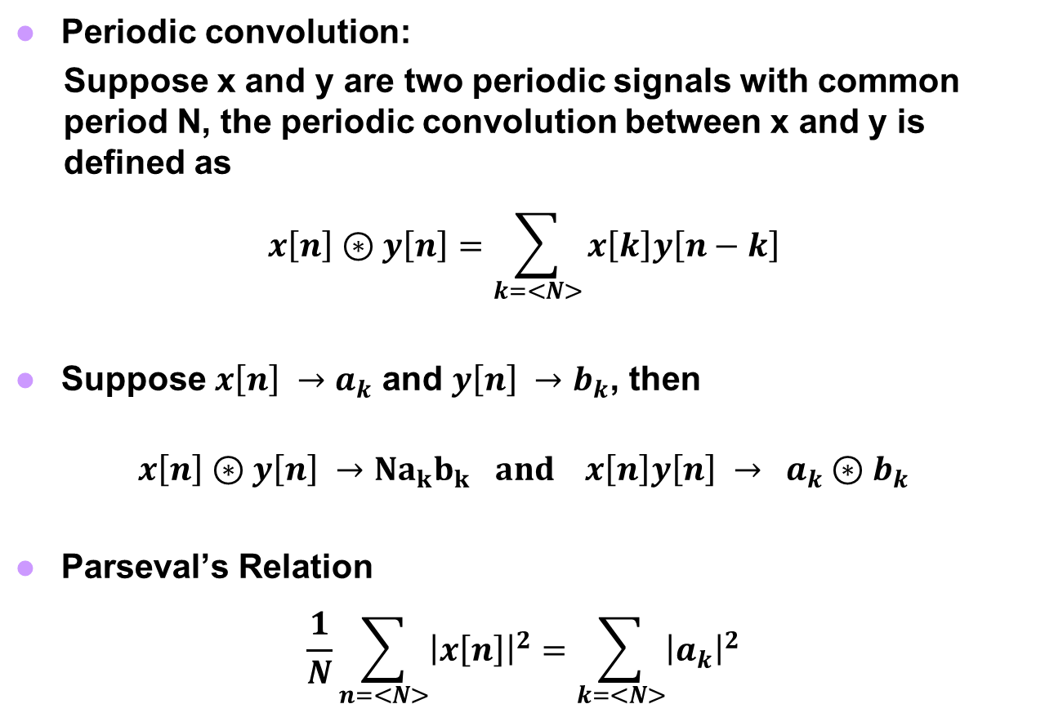
Two Important Properties
Periodic convolution:
Suppose x and y are two periodic signals with common period N, the periodic convolution between x and y is defined as
$$x\left[n\right]⊛y\left[n\right]=\sum_{k=<N>}{x\left[k\right]y\left[n−k\right]}$$
Suppose $x\left[n\right] →a_{k}$ and $y\left[n\right] →b_{k}$, then
$$x\left[n\right]⊛y\left[n\right] →Na_{k}b_{k } and x\left[n\right]y\left[n\right] → a_{k}⊛b_{k}$$
Parseval’s Relation
$$\frac{1}{N}\sum_{n=<N>}{{\left|x\left[n\right]\right|}^{2}}=\sum_{k=<N>}{{\left|a_{k}\right|}^{2}}$$

Slide 17
Frequency Behavior of LTI Systems

Slide 18
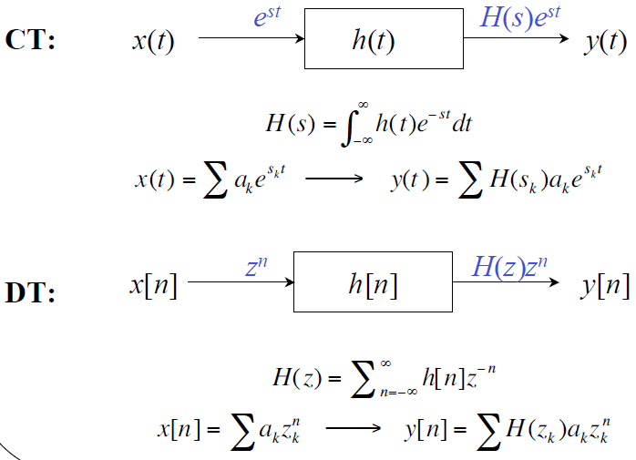
System Functions H(s) or H(z)
Review

Slide 19
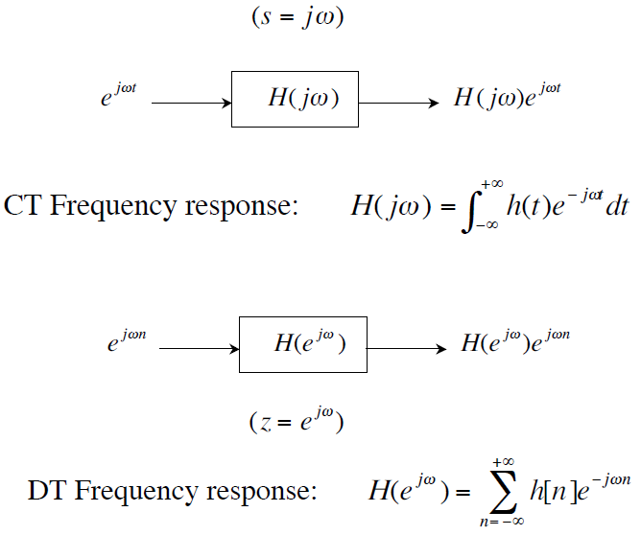
Frequency Response of an LTI System
Periodic

Slide 20
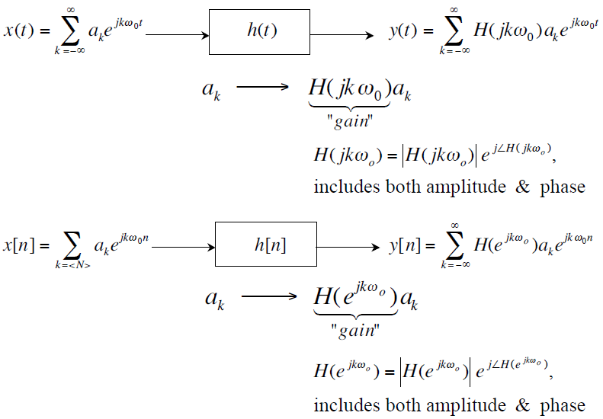


Fourier Series and LTI Systems
$$H(jω)$$
$$H(e^{jω})$$
The effect of the LTI system is to modify each a_{k} through multiplication by the value of the frequency response at the corresponding frequency.

Slide 21
Example 3.17
x[n]
y[n]
y[n], y(t)
h[n], h(t)
h[n]

Slide 22
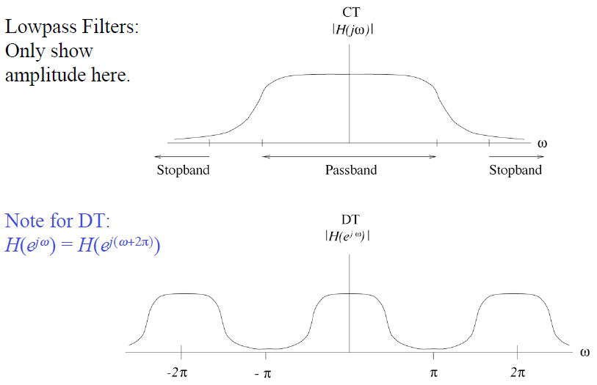
Lowpass Filter

Slide 23
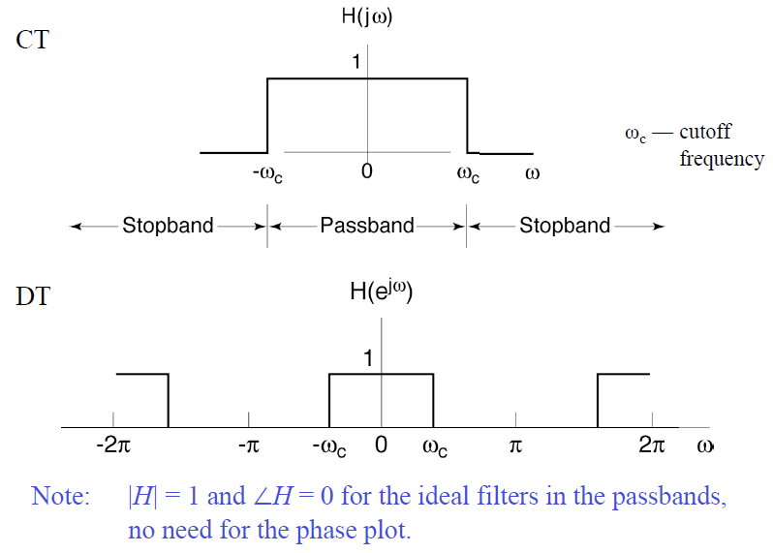
Ideal Lowpass Filter

Slide 24
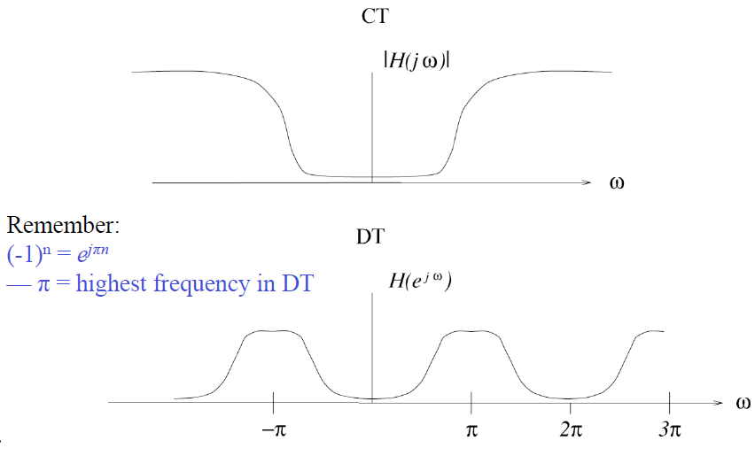
Highpass Filters

Slide 25
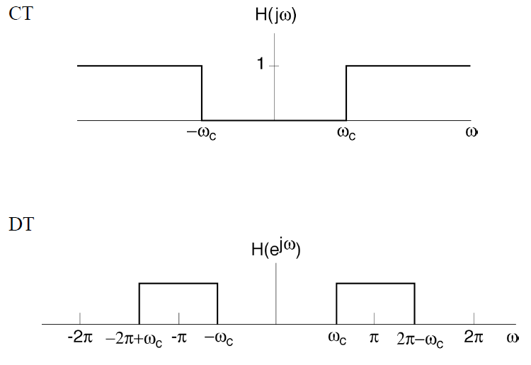
Ideal Highpass Filter

Slide 26
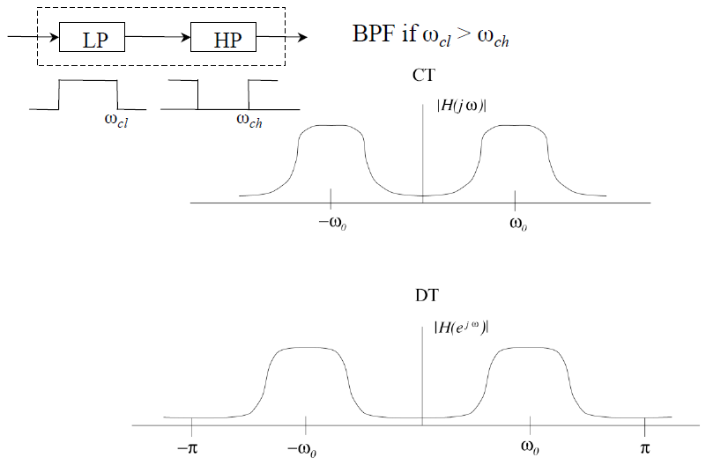
Bandpass Filters

Slide 27
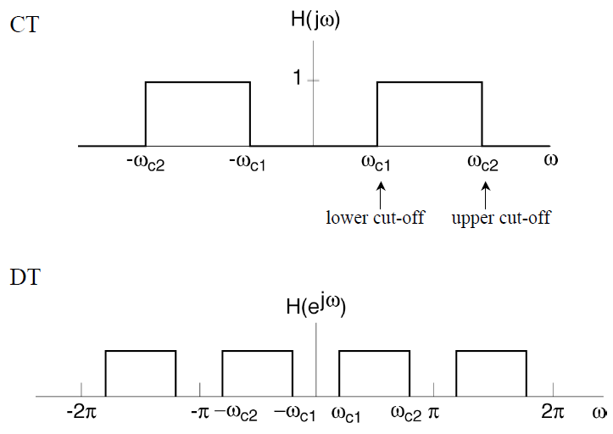
Ideal Bandpass Filter

Slide 28
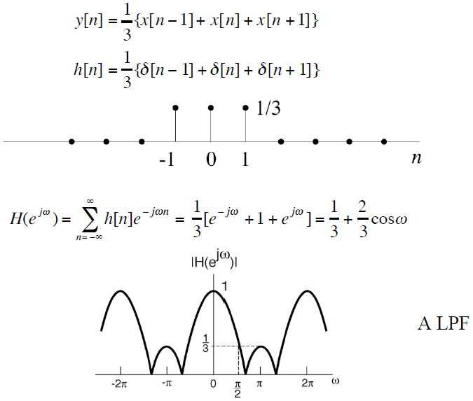
Example: DT Averager/Smoother
Frequency response:

Slide 29
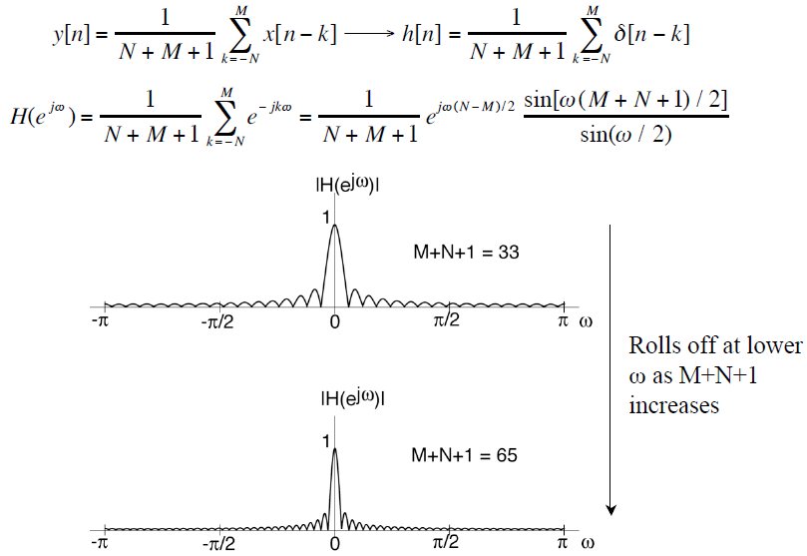
Example: Nonrecursive DT (FIR) filters
Frequency response:

Slide 30
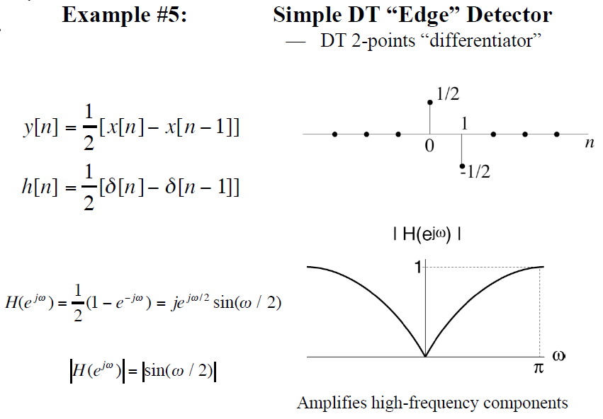
Frequency response:

Slide 31
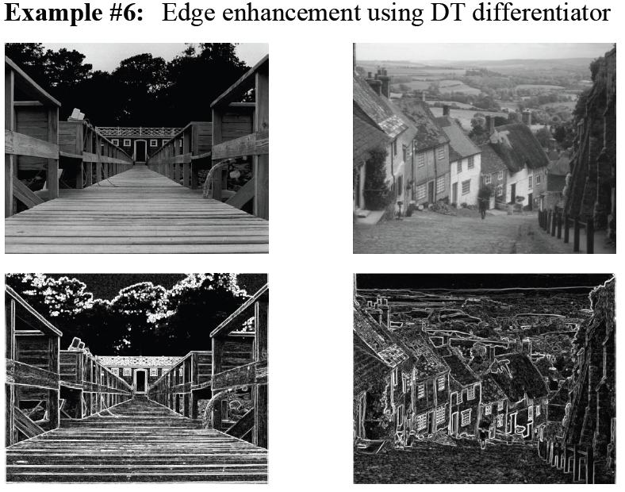

Slide 32
Summary
DT Fourier Series pair
Understand the difference between CT and DT
Frequency response
How to determine frequency response?
Filtering

